Slide 1
Component 5:
Widely Used Functions/Blocks
Functions and functional blocks
Rudimentary logic functions
Decoding
Encoding
Selecting
Chapter 4 <number>

Slide 2
Component 5:
Widely Used Functions/Blocks
Functions and functional blocks
Rudimentary logic functions
Decoding
Encoding
Selecting
Chapter 4 <number>

Slide 3
Functions and Functional Blocks
The functions considered are those found to be very useful in design
Corresponding to each of the functions is a combinational circuit implementation called a functional block.
In the past, many functional blocks were implemented as SSI, MSI, and LSI circuits.
Today, they are often simply parts within a VLSI circuits.
Chapter 4 <number>

Slide 4
Component 5:
Widely Used Functions/Blocks
Functions and functional blocks
Rudimentary logic functions
Decoding
Encoding
Selecting
Chapter 4 <number>

Slide 5
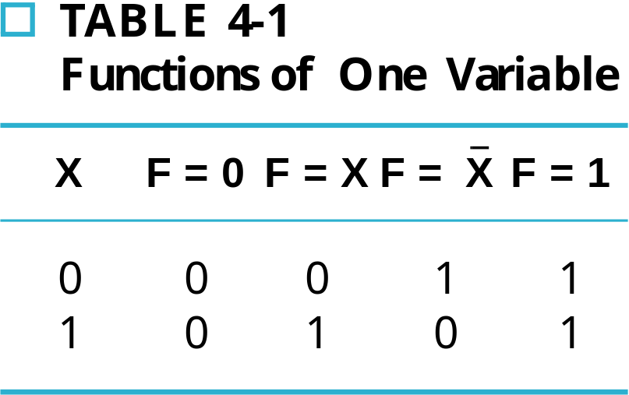
Rudimentary Logic Functions
Functions of a single variable X
V
CC
or V
DD
1
F
=
1
F
=
1
X
F
=
X
(c)
0
F
=
0
F
=
0
X
F
=
X
(a)
(b)
(d)
Chapter 4 <number>

Slide 6
Rudimentary Logic Functions
Functions of two variables (X,Y)
What is
  F₀? F₁₅?
  F₁? F₁₄?
  F₆? F₉?
XY | F0 | F1 | F2 | F3 | F4 | F5 | F6 | F7 | F8 | F9 | F10 | F11 | F12 | F13 | F14 | F15
00 | 0 | 0 | 0 | 0 | 0 | 0 | 0 | 0 | 1 | 1 | 1 | 1 | 1 | 1 | 1 | 1
01 | 0 | 0 | 0 | 0 | 1 | 1 | 1 | 1 | 0 | 0 | 0 | 0 | 1 | 1 | 1 | 1
10 | 0 | 0 | 1 | 1 | 0 | 0 | 1 | 1 | 0 | 0 | 1 | 1 | 0 | 0 | 1 | 1
11 | 0 | 1 | 0 | 1 | 0 | 1 | 0 | 1 | 0 | 1 | 0 | 1 | 0 | 1 | 0 | 1
Chapter 4 <number>

Slide 7
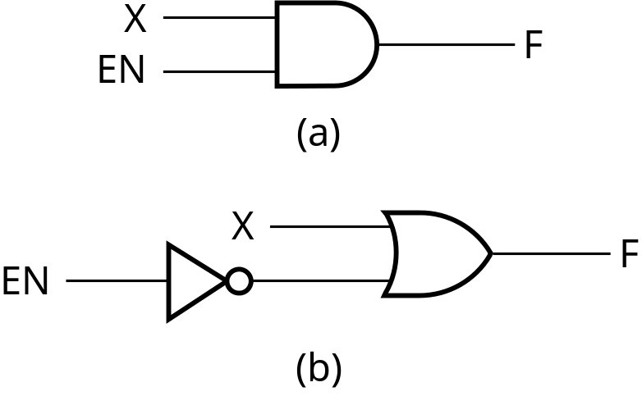
Enabling Function
Enabling permits an input signal to pass through to an output
Disabling blocks an input signal from passing through to an output, replacing it with a fixed value
The value on the output when it is disabled can be 0 , or 1
When disabled, 0 output
When disabled, 1 output
Chapter 4 <number>

Slide 8
Component 5:
Widely Used Functions/Blocks
Functions and functional blocks
Rudimentary logic functions
Decoding
Encoding
Selecting
Chapter 4 <number>

Slide 9
Decoding
Decoding - the conversion of an n-bit input code to an m-bit output code with
m = 2^{n} such that each valid code word produces a unique output code
Circuits that perform decoding are called decoders
Here, functional blocks for decoding are
  called nxm decoders, where m = 2^{n}, and
  generate 2^{n} minterms for the n input variables
Chapter 4 <number>

Slide 10
Decoder Examples
1x2 Decoder
2x4 Decoder
A
D
0
D
1
D
0
=
A
0
1
0
1
0
1
A
D
=
A
1
(a)
(b)
A
0
A
1
A
0
D
0
D
1
D
2
D
3
A
1
0
0
1
0
0
0
D
=
A
A
0
1
0
1
0
0
0
1
0
1
0
0
0
1
0
1
1
0
0
0
1
D
1
=
A
1
A
0
(a)
Note that the 2x4 decoder is
made up of 2 1x2 decoders and 4 AND gates.
D
2
=
A
1
A
0
D
3
=
A
1
A
0
(b)
Chapter 4 <number>

Slide 11
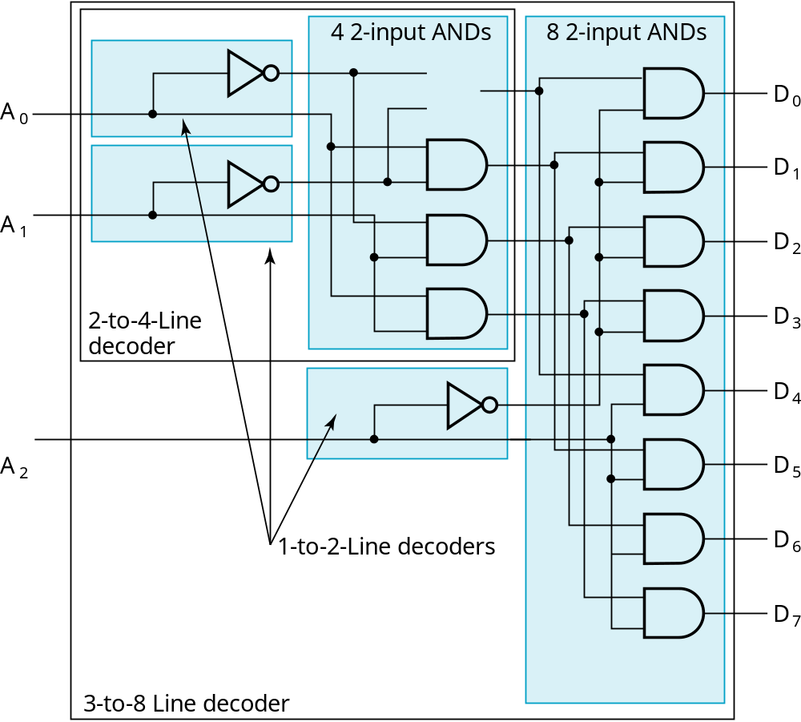
Hierarchically Designed Decoder
Result
2x4 dec.
3 1x2 dec.
3x8 dec.
Chapter 4 <number>

Slide 12
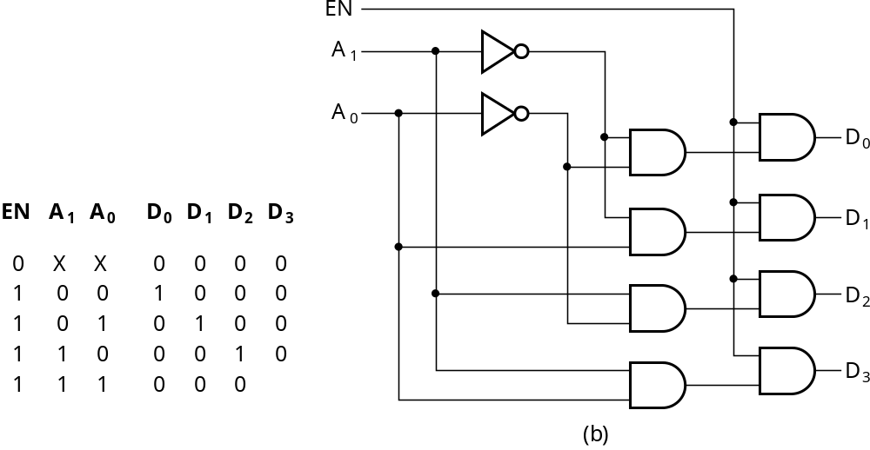
Decoder with Enable
See truth table below for function
  Combination containing two X’s represent four binary combinations
Alternatively, can be viewed as distributing value of signal EN to 1 of 4 outputs
Decoder with no enable
Chapter 4 <number>

Slide 13
Component 5:
Widely Used Functions/Blocks
Functions and functional blocks
Rudimentary logic functions
Decoding
Encoding
Selecting
Chapter 4 <number>

Slide 14
Encoding
Encoding - the opposite of decoding - the conversion of an m-bit input code to a n-bit output code with m = 2^{n} such that each valid code word produces a unique output code
Circuits that perform encoding are called encoders
An encoder has 2^{n} input lines and n output lines which generate the binary code corresponding to the input values
Typically, an encoder converts a code containing exactly one bit, that is 1, to a binary code corres-ponding to the position in which the 1 appears.
Chapter 4 <number>

Slide 15
Encoder Example
A decimal-to-BCD encoder
  Inputs: 10 bits corresponding to decimal digits 0 through 9, (D₀, …, D₉)
  Outputs: 4 bits with BCD codes
  Function: If input bit D_{i} is a 1, then the output (A₃, A₂, A₁, A₀) is the BCD code for i,
The truth table could be formed, but alternatively, the equations for each of the four outputs can be obtained directly.
Chapter 4 <number>

Slide 16
Encoder Example (continued)
Input D_{i} is a term in equation A_{j} if bit A_{j} is 1 in the binary value for i.
Equations:
  A₃ = D₈ + D₉
  A₂ = D₄ + D₅ + D₆ + D₇
  A₁ = D₂ + D₃ + D₆ + D₇
  A₀ = D₁ + D₃ + D₅ + D₇ + D₉
F₁ = D₆ + D₇ can be extracted from A₂ and A₁ Is there any cost saving?
Chapter 4 <number>
Notes:
No. The total gate input cost remains the same.

Slide 17
Priority Encoder
If more than one input value is 1, then the encoder just designed does not work.
One encoder that can accept all possible combinations of input values and produce a meaningful result is a priority encoder.
Among the 1s that appear, it selects the most significant input position (or the least significant input position) containing a 1 and responds with the corresponding binary code for that position.
Chapter 4 <number>

Slide 18
Priority Encoder Example
Priority encoder with 5 inputs (D₄, D₃, D₂, D₁, D₀) - highest priority to most significant 1 present - Code outputs A2, A1, A0 and V where V indicates at least one 1 present.
Inputs |  |  |  |  | Outputs
D4 | D3 | D2 | D1 | D0 | A2 | A1 | A0 | V
0 | 0 | 0 | 0 | 0 | X | X | X | 0
0 | 0 | 0 | 0 | 1 | 0 | 0 | 0 | 1
0 | 0 | 0 | 1 | X | 0 | 0 | 1 | 1
0 | 0 | 1 | X | X | 0 | 1 | 0 | 1
0 | 1 | X | X | X | 0 | 1 | 1 | 1
1 | X | X | X | X | 1 | 0 | 0 | 1
Chapter 4 <number>
Notes:
Go over table explaining how entries were obtained, particularly those containing Xs

Slide 19
Priority Encoder Example (continued)
Could use a K-map to get equations, but can be read directly from table and manually optimized if careful:
  A₂ = D₄
  A₁ = D₃ + D₂ = F₁, F₁ = (D₃ + D₂)
  A₀ = D₃ + D₁ = (D₃ + D1)
  V = D₄ + F₁ + D₁ + D₀
D4
D4
D3
D4
D4
D4
D3
D2
D4
D2
Chapter 4 <number>

Slide 20
Component 5:
Widely Used Functions/Blocks
Functions and functional blocks
Rudimentary logic functions
Decoding
Encoding
Selecting
Chapter 4 <number>

Slide 21
Selecting
Selecting of data or information is a critical function in digital systems and computers
Circuits that perform selecting have:
  A set of information inputs from which the selection is made
  A single output
  A set of control lines for making the selection
Logic circuits that perform selecting are called multiplexers
Chapter 4 <number>

Slide 22
Multiplexers
A multiplexer selects information from an input line and directs the information to an output line
A typical multiplexer has n control inputs (S_{n − 1}, … S₀) called selection inputs, 2^{n} information inputs (I₂^{n} ₋ ₁, … I₀), and one output Y
Chapter 4 <number>

Slide 23
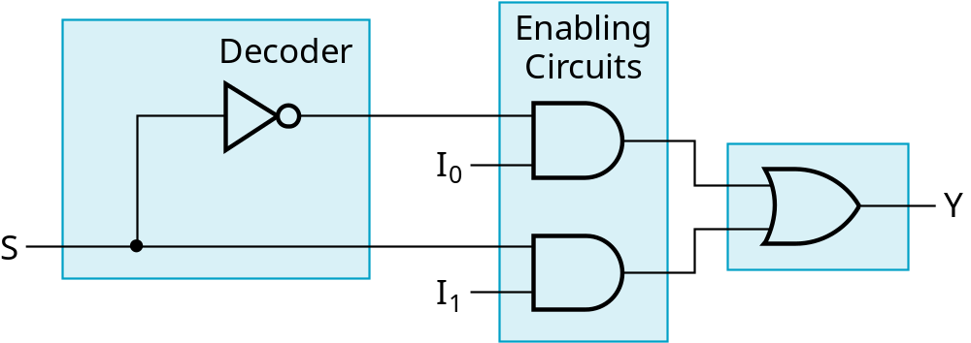
2-to-1-Line Multiplexer
Since 2 = 2¹, n = 1
The single selection variable S has two values:
  S = 0 selects input I₀
  S = 1 selects input I₁
The equation:
Y = I₀ + SI₁
The circuit:
S
Chapter 4 <number>

Slide 24
2-to-1-Line Multiplexer (continued)
Note the regions of the multiplexer circuit shown:
  1x2 Decoder
  2 Enabling AND gates
  1 2-input OR gate
To obtain a basis for multiplexer expansion, we combine the Enabling circuits and OR gate into a AND-OR circuit with 2 AND gates:
  1x2 decoder
  AND-OR circuit: 2 AND + 1 OR
In general, for an 2^{n}-to-1-line multiplexer:
  nx2^{n} decoder
  AND-OR circuit: 2^{n} AND + 1 OR
Chapter 4 <number>

Slide 25
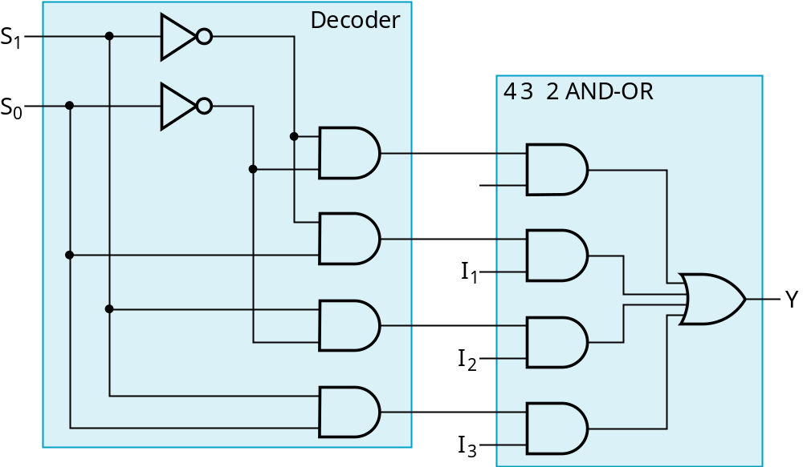
Example: 4-to-1-line Multiplexer
2x4 decoder
AND-OR: 4 AND + 1 OR
4 AND + 1 OR
Chapter 4 <number>

